Slide 1
Wellness App
Ange Gakwaya

Slide 2
The Wellness App is a web application that aims to improve overall wellbeing and mindfulness through meditation, reflection, and journaling.
Key features: Meditation: soothing sounds and visual cues Explore reflective questions across various categories Write and save journal entries to track your thoughts and reflections.
Technical features:
Single page html application
Data from c# webapi
CSS, JavaScript
About

Slide 3
Stakeholders
Product Owner:
Responsible for the overall vision and delivery of the product. They are the are the bridge between stakeholders and development teams.
Project Manager:
Ensures the project is on track to delivery. They plan the workload and ensure the work is done to the right standard
Solution Architects:
Responsible for designing technical solutions and how they integrate to existing systems
Software Engineers:
Responsible for the design, development, testing, and maintenance of software
Business Analysts:
Research and analysis to solutions to business problems

Slide 4
User Research and MoScoW Prioritization
Must Have | Should Have | Could Have | Will Not Have
Meditation Functionality: Develop the core functionality for guided meditation, allowing users to initiate, pause, and stop meditation sessions through breathwork | Enhance the reflective questions feature by categorizing them for easy navigation and selection. | Customizable Meditation Sessions: Implement the ability for users to customize the duration and focus of meditation sessions. | Social Media Integration: Allow users to share their reflections or achievements on social media platforms.
Reflective questions across various categories to facilitate user introspection and personal growth. | Develop user profiles track user progress in meditation and reflection. | Habit tracker for when the user logs in to meditate
Create a journaling feature that allows users to save and review their thoughts and reflections over time. | User Authentication (Login/Logout): Implement a secure user authentication system to protect user data and ensure a personalized experience.

Slide 5
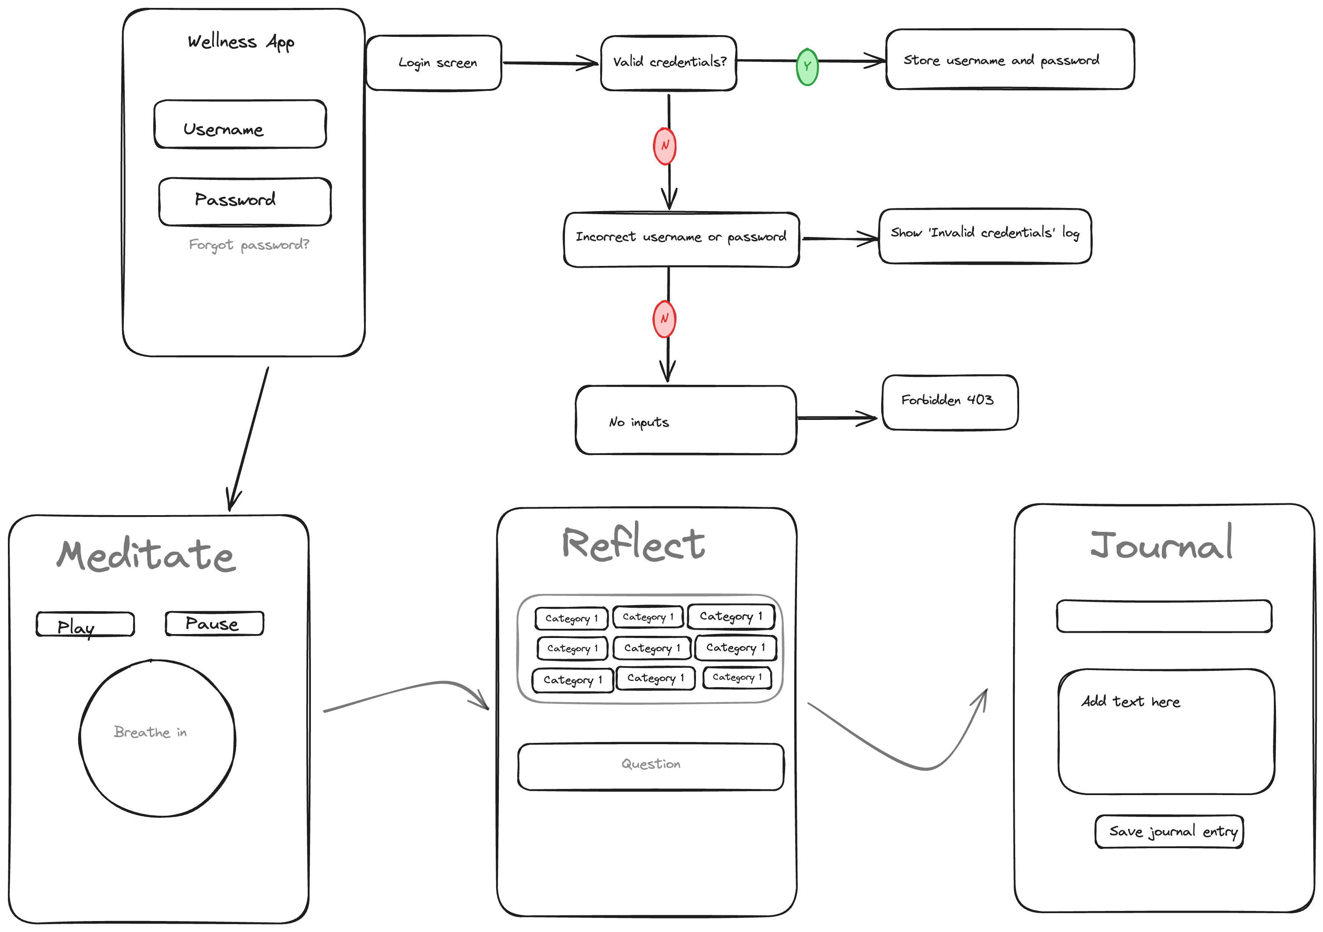
UI Wireframe

Slide 6
Functional Requirements
ID | Description | Acceptance Criteria | Priority
001 | User Authentication | Users should be able to create accounts, log in, and log out securely. | High
002 | Meditation Timer | Users can set and start a meditation timer | High
003 | Reflective Questions | Display curated reflective questions based on different categories. Users can select and answer questions. | High
004 | Journal Entry | Users can create, edit, and delete journal entries. | High
005 | Save Journal Entries | Save journal entries for future reference. | High
006 | Meditation Sound | Users can play and pause soothing meditation sounds during meditation sessions. | Medium
007 | Category Buttons | Display clickable category buttons for easy navigation to specific types of reflective questions. | High

Slide 7
Non-Functional Requirements
ID | Description | Acceptance Criteria | Priority
001 | Performance | The system should have 99.9% uptime, ensuring users can access meditation and reflection tools reliably. | High
002 | Accessibility | The app should follow accessibility standards to ensure usability for users with disabilities. | High
003 | Performance | The app should load reflective questions and journal entries within 3 seconds on standard internet speeds. | High
004 | Browser Compatibility | The app should be compatible with major web browsers such as Chrome, Firefox, Safari, and Edge. | Medium

Slide 8
User stories
As a user, I want to log in securely to access personalized content and features.
As a user, I want to start and stop meditations with a button
As a user, I want to explore different categories of reflective questions to guide my introspection.
As a user, I want to answer reflective questions and save my responses for future reference.
As a user, I want to create, edit, and delete journal entries.
As a user, I want to play and pause soothing meditation sounds during my meditation sessions.
As a user, I want to view and update my profile information and profile picture.
As a user, I want to save my meditation preferences for a personalized experience.
As a user, I want the app to load quickly, providing a seamless experience.
As a user, I want my data (journal entries) to be stored securely
As a user, I want the app to be compatible on web and mobile

Slide 9
Jan 27 - Jan 31
Feb 17 - Feb 21
Feb 21 - Feb 27
Feb 21 - Feb 27
Mar 10 - Mar 12
Mar 17
Jan 21
Feb 17
Mar 20
Feb 3 - Feb 10
Feb 7 - Feb 14
Feb 26 - Mar 6
Feb 28 - Mar 7
Mar 4 - Mar 7
Mar 4
0%
0%
0%
0%
0%
0%
0%
0%
0%
0%
2022
2022
Software Development Gantt chart
Define requirements
3 days
Design user interface
6 days
Implement front end
6 days
Implement back end
3 days
Develop meditation feature
5 days
Develop reflection feature
5 days
Develop journaling feature
5 days
Implement user authentication
6 days
Bug fixing
2 days
Release
2 days
Production
Day 1
6
11
16
21
26
31
36
41
46
51
56
Project Approval
Project Release

